Slide 1

Gilbert Lau Partner Architect Sept 16, 2016
RFP – 100AZ-2205
Umbrella Corp’s RFP Response

Slide 2
1 | Umbrella Corp’s Requirements
2 | DataStax Solution
3 | Guided Implementation
4 | Demo

Slide 3

Umbrella Corp’s Requirements

Slide 4
Project Requirements
Need an IoT platform to process humongous amount of sensor data located in 4 hives in different geographical locations to gain business insight in order to make better informed decision.
Sensor data needs to be ingested, transformed and rolled up either in real time or at specific time intervals.
Sensor data must be analyzed by any attributes, combination of attributes, or analyzed through dynamic analytic patterns within 200 ms latency.
Sensor metadata will be searchable by any attribute.
Sensor data to be encrypted both in motion and at rest.
Sensor data needs to be highly available and local to its respective hive for fast access and continuous availability.
Secured access and inter-component security are required.
Initial sizing estimate to support currently planned 4 hives capacity with projected growth rate of new hives in your IoT platform.

Slide 5
DataStax Solution

Slide 6
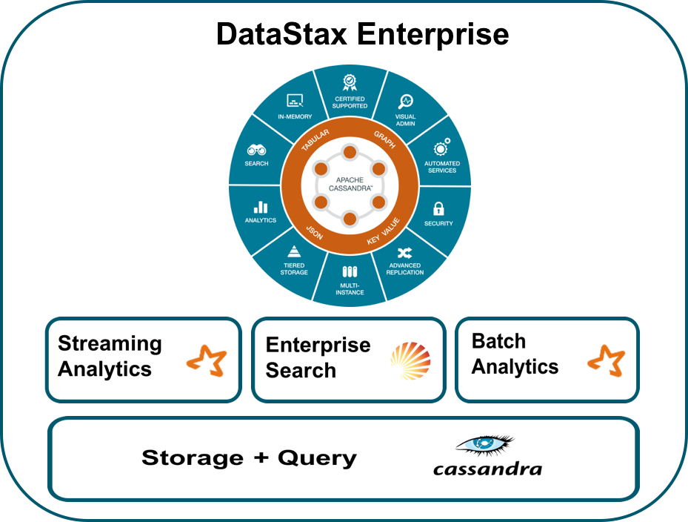


Logical Solution Architecture

Slide 7


Deployment Topology [Search+Analytics C* Nodes]
DC : SA-H2
Hive 2
Hive 1
Hive 3
SearchAnalytics
Cluster [SA]
DC : SA-H1
DC : SA-H3
Hive 4
DC : SA-H4
IC: R.CL + W.CL > RF
R/W access: DC-Aware
Single C* cluster across all DCs
Single DC in each Hive location

Slide 8


Deployment Topology [Dedicated Search and Analytics DCs]
DC : AC-H2
DC : SC-H2
Hive 2
Hive 1
Hive 3
SearchAnalytics
Cluster[SA]
Hive 4
DC : AC-H1
DC : SC-H1
DC : SC-H3
DC : AC-H3
IC: R.CL + W.CL > RF
R/W access: DC-Aware
Single C* cluster across all DCs
Dedicated DCs for Search & Analytics in each Hive location
DC : SC-H4
DC : AC-H4

Slide 9
Initial Sizing Estimate (based on 4 Hives)
Sensor Metadata |  |  | Raw Sensor Data
Sensor metadata size in bytes | 500 |  | Sensor record size in bytes | 1,000
No. of floors | 25 |  | Seconds in day | 86,400
No. of hives | 4 |  | Emit data every 5 seconds | 5
No. of sensors per floor | 100 |  | Raw sensor data emission per day per sensor | 17,280
Total number of sensors | 10,000 |  | Total number of sensors | 10,000
Required storage in bytes | 5,000,000 |  | Total data ingested thru DStrem every 5 seconds (bytes) | 172,800,000,000
Required storage in bytes with RF = 3 in each DC | 60,000,000 |  | Total data ingested into Cassandra DB per minute | 14,400,000,000
Required storage in MB with RF = 3 in each DC | 60 MB |  | TTL days | 90
 |  |  | Required storage in bytes with TTL = 90 | 1,296,000,000,000
Aggregated Sensor Data |  |  | Required storage in TB | 1.30
Sensor record size in bytes | 1,000 |  | Required storage in TB when RF in each DC = 3 | 16 TB
TBTotal number of sensors | 10,000
TTL days | 90
Required storage in bytes with RF = 3 in each DC | 10,800,000,000
Required storage in GB with RF = 3 in each DC | 11 GB

Slide 10
Enterprise Grade Security
DataStax Enteprise (DSE) Feature | DSE Security | DSE Searh with Solr | DSE Analytics with Spark
Internal authentication / LDAP | Yes | Partial (CQL: Yes; HTTP: No) | Yes (CQL: Yes; HTTP: No)
Object permission management | Yes | Partial (CQL: Yes; Solr Cache & indexes: No) | Yes
Client-to-node encryption | Yes (via SSL) | Yes (HTTP and Inter-node over SSL) | Yes (Spark Executor to Cassandra over SSL)
Kerberos authentication | Yes (Inter-node via SSL) | Yes | Yes (CQL: Yes; HTTP: No)
Data auditing | Yes | Yes | Partial (Spark data audited at Cassandra access level)
For more information | http://docs.datastax.com/en/datastax_enterprise/5.0/datastax_enterprise/sec/secDSE.html

Slide 11
Guided Implementation

Slide 12
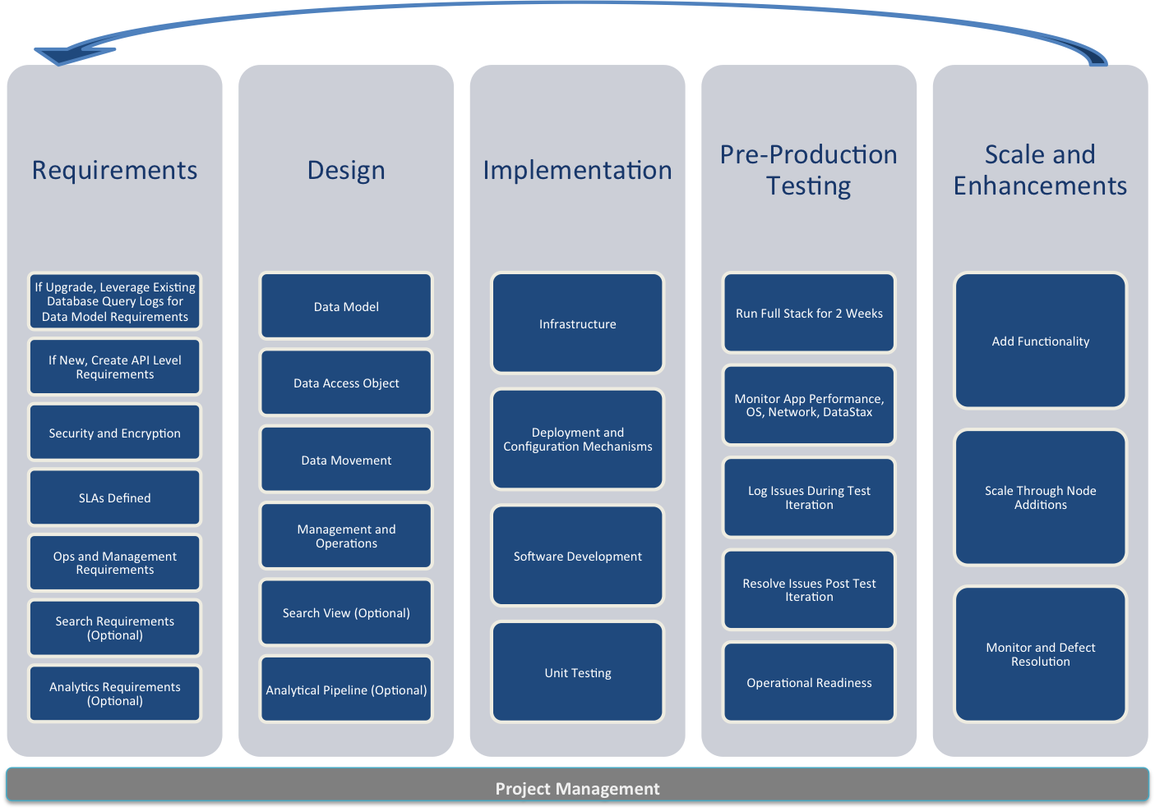
Implementation Methodology

Slide 13

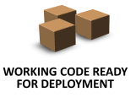
Implementation Model – Collaborative Scrum
Sprint
Planning
Daily Scrum
Product Increment
Sprint Demo / Review
Sprint Retrospective
Update Product Backlog
X days sprint
Umbrella
DataStax
System Integrator

Slide 14
Demo

Slide 15
Demo Scenario
Sensor metadata has been loaded into a Cassandra table
Sensor data has been generated and loaded into a Cassandra table via Spark Streaming (DSE Analytics) with a time window and a slider
Daily roll-up of aggregated sensor data is stored in a Cassandra table via a Spark job (DSE Analytics)
The sensor data table has been indexed by DSE Search (Solr) for later ad-hoc queries purpose
The sensor data table is enabled for Geospatial search to identify hotspots
Apache Zeppelin will be used to demonstrate this working system

Slide 16
Thank You!

